Slide 1
The Caribbean's Influence on Contemporary British Art
‘Life Between Islands’ Exhibition Review
IDIS305
Seloma Yao

Slide 2
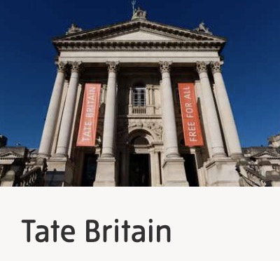
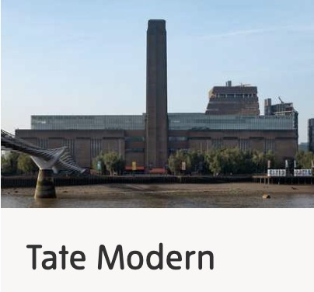
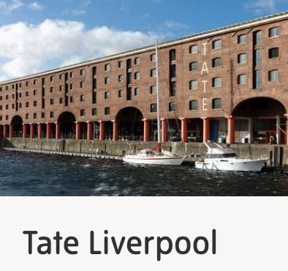
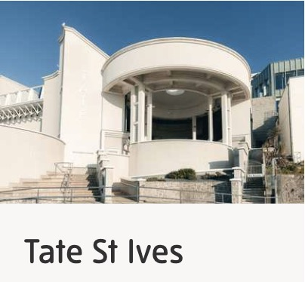
Tate Gallaries
Mission: To increase the public’s enjoyment and understanding of British art from the 16th century to the present day and of international modern and contemporary art.

Slide 3
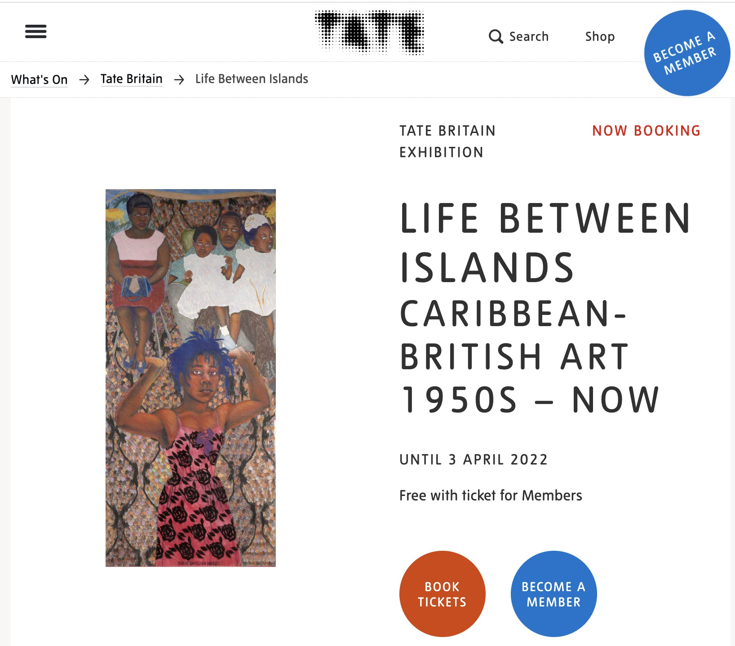
Introduction of Life Between Islands
- the importance and uniqueness of Caribbean British art
- new communities and identities
- in the process integrates, transforms, and develops British society and culture today
website information

Slide 4
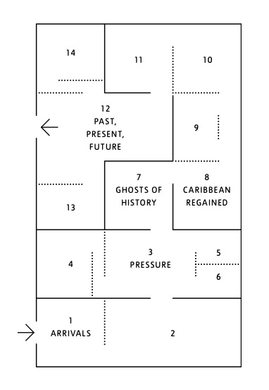
Five Chapters of Life Between Islands
Arrivals
Pressure
Ghosts of History
Caribbean Regained: Carnival and Creolisation
Past, Present, Future
exhibition map

Slide 5
Highlights of This Exhibition
The variety of forms of art selected for the exhibition
painting, documentary photography, fashion, film, and sculpture
reflecting the diversity and broadness of Caribbean-British culture
How different chapters are grouped in roughly chronological order
to better understand the logic and meaning behind the works of art

Slide 6
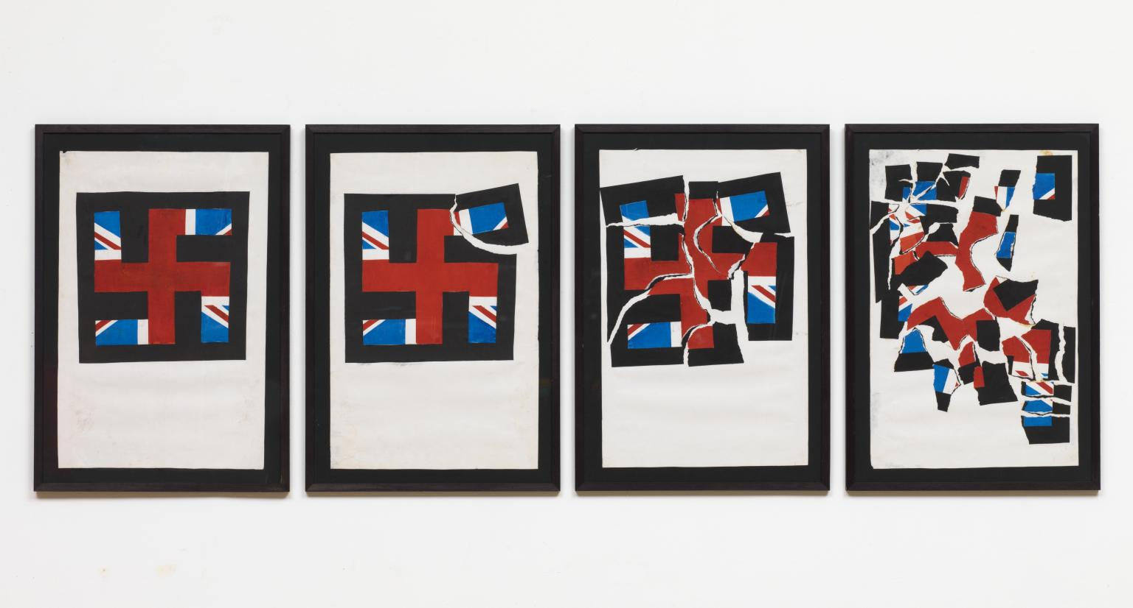
Destruction of the National Front by Eddie Chambers
https://www.tate.org.uk/art/artworks/chambers-destruction-of-the-national-front-t13887

Slide 7
The National Front is a far-right, fascist political party in the United Kingdom.
“National Front”?

Slide 8
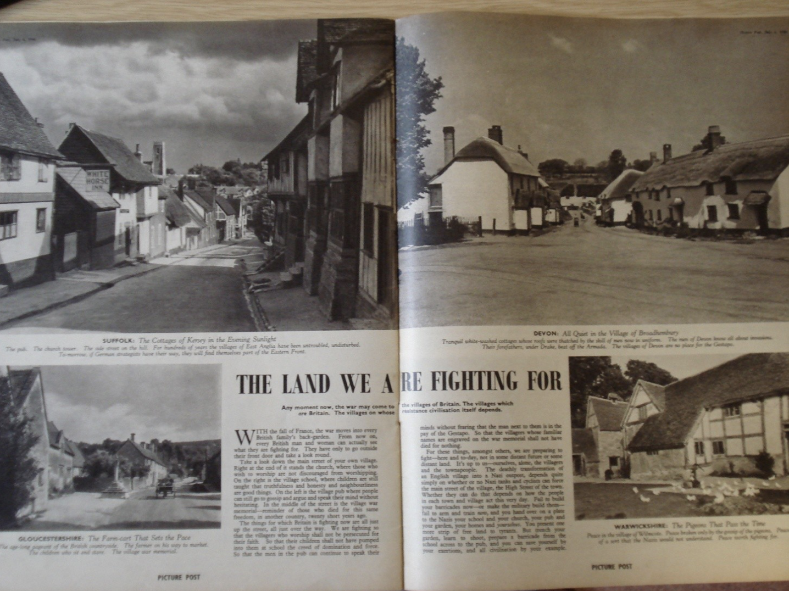
The Land We are Fighting for, 1940
“But trench your garden, learn to shoot, prepare a barricade from the school across to the pub, and you can save yourself by your exertions, and all civilization by your example.”
week 3 course material

Slide 9
- to destroy this extremist party
- to destroy the walls erected by neo-fascism, racism, and ultra-nationalism in the British community

Slide 10
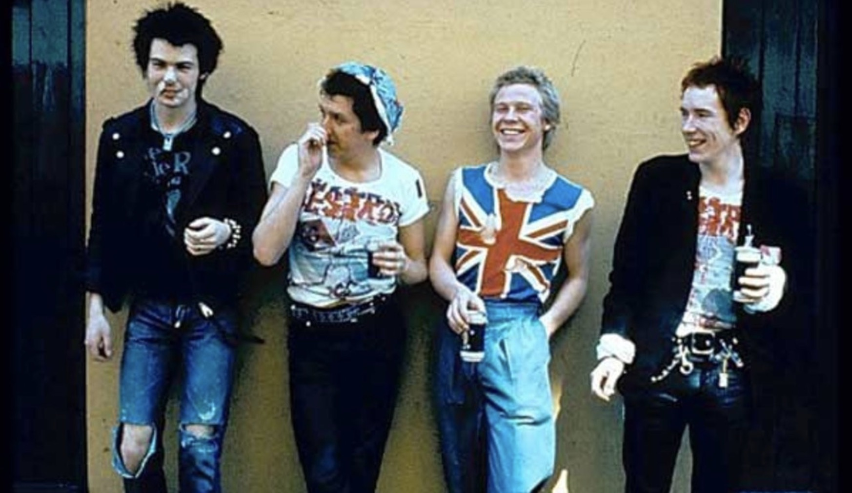
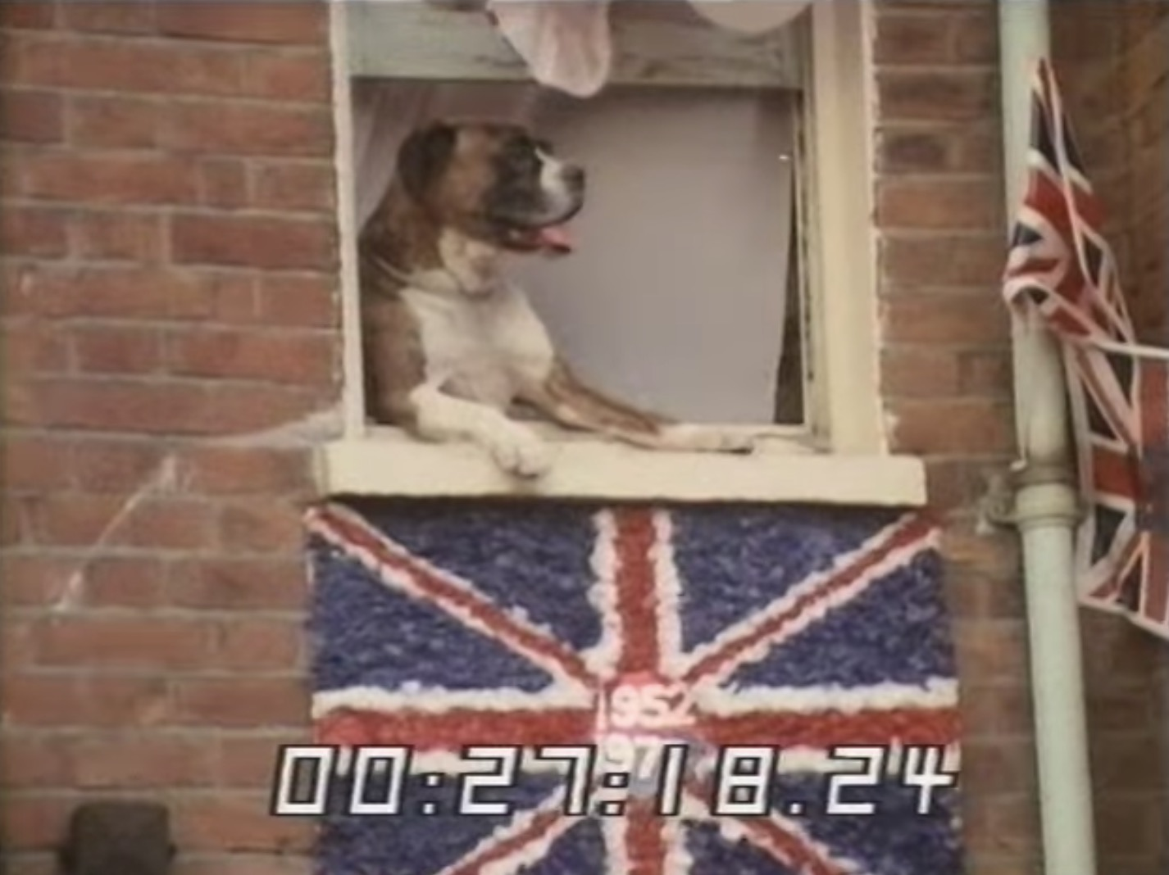

To provoke the audience to reflect on how cultural exchanges between the Caribbean and the UK should resolve conflicts and disagreements
week 10 course materials

Slide 11


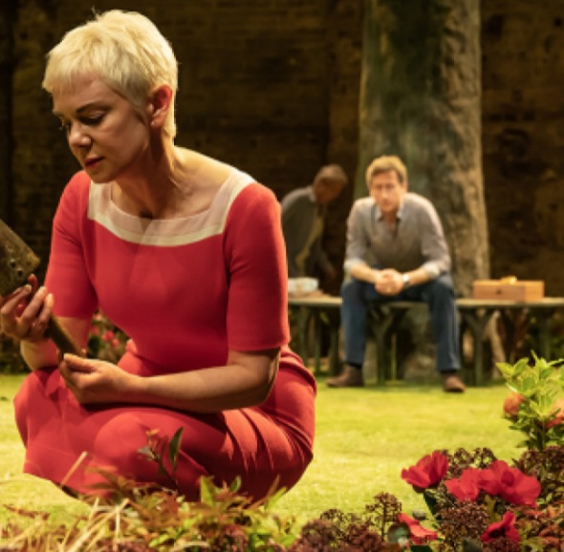
Albion by Mike Bartlett - nostalgia
the last collage of the Destruction of the National Front
Albion (Almeida Theatre)

Slide 12
Conclusion
explores how the history of the UK is deeply intertwined with that of the Caribbean
necessity and importance of discussing the cultural exchanges between the Caribbean and the UK
a national rethink of British history
prompting institutions to rethink the stories they tell and the communities they represent

Slide 13
References
https://www.tate.org.uk/about-us/history-tate/history-tate-britain
https://www.tate.org.uk/about-us/history-tate
https://www.tate.org.uk/about-us
https://www.tate.org.uk/whats-on/tate-britain/life-between-islands
https://www.tate.org.uk/whats-on/tate-britain/life-between-islands/exhibition-guide
https://www.tate.org.uk/art/artworks/chambers-destruction-of-the-national-front-t13887

